Slide 1
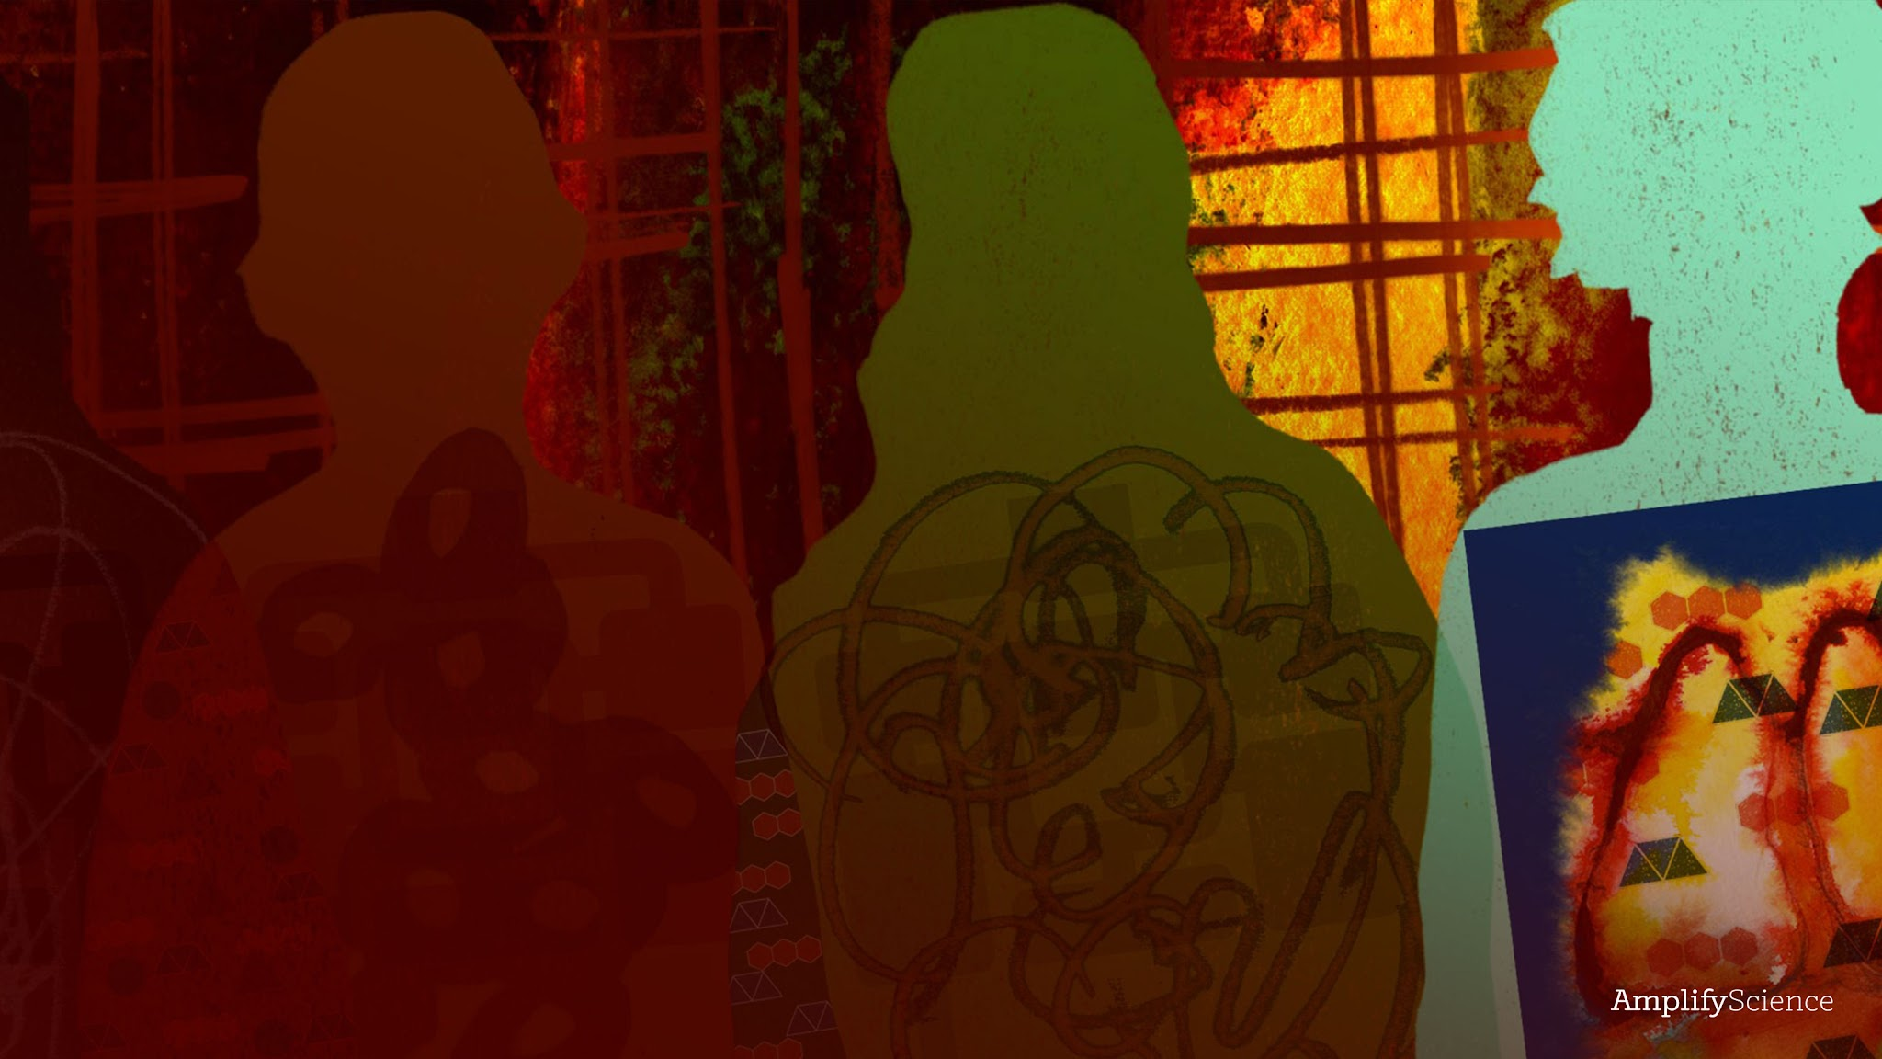
Metabolism
Lesson 2.1: Exploring the Classroom Body Systems Model

Slide 2
Warmup pg 21
What do you notice about the path oxygen molecules take inside the Metabolism Simulation of a healthy body?
Launch the Metabolism Simulation.
Select HEALTHY BODY.
Select OBSERVE.
Focus on just oxygen by pressing on the other molecules at the bottom of the screen to hide them.
Observe and describe how oxygen moves through different parts of the body.

Slide 3
Investigation Question:
How do molecules from food and air get to the cells in the body?

Slide 4
Introducing the Classroom Body Systems Model
We’ll use a new model to help investigate our question. The Sim is a computer model.
Today, we’ll create a different kind of model: a classroom-sized physical model of the systems in the human body that transport molecules to and from cells.
You will work in groups of four. Each group member will play a role in the model based on a Role Card. Three people will play the three body system roles, and one will play a cell role.

Slide 5
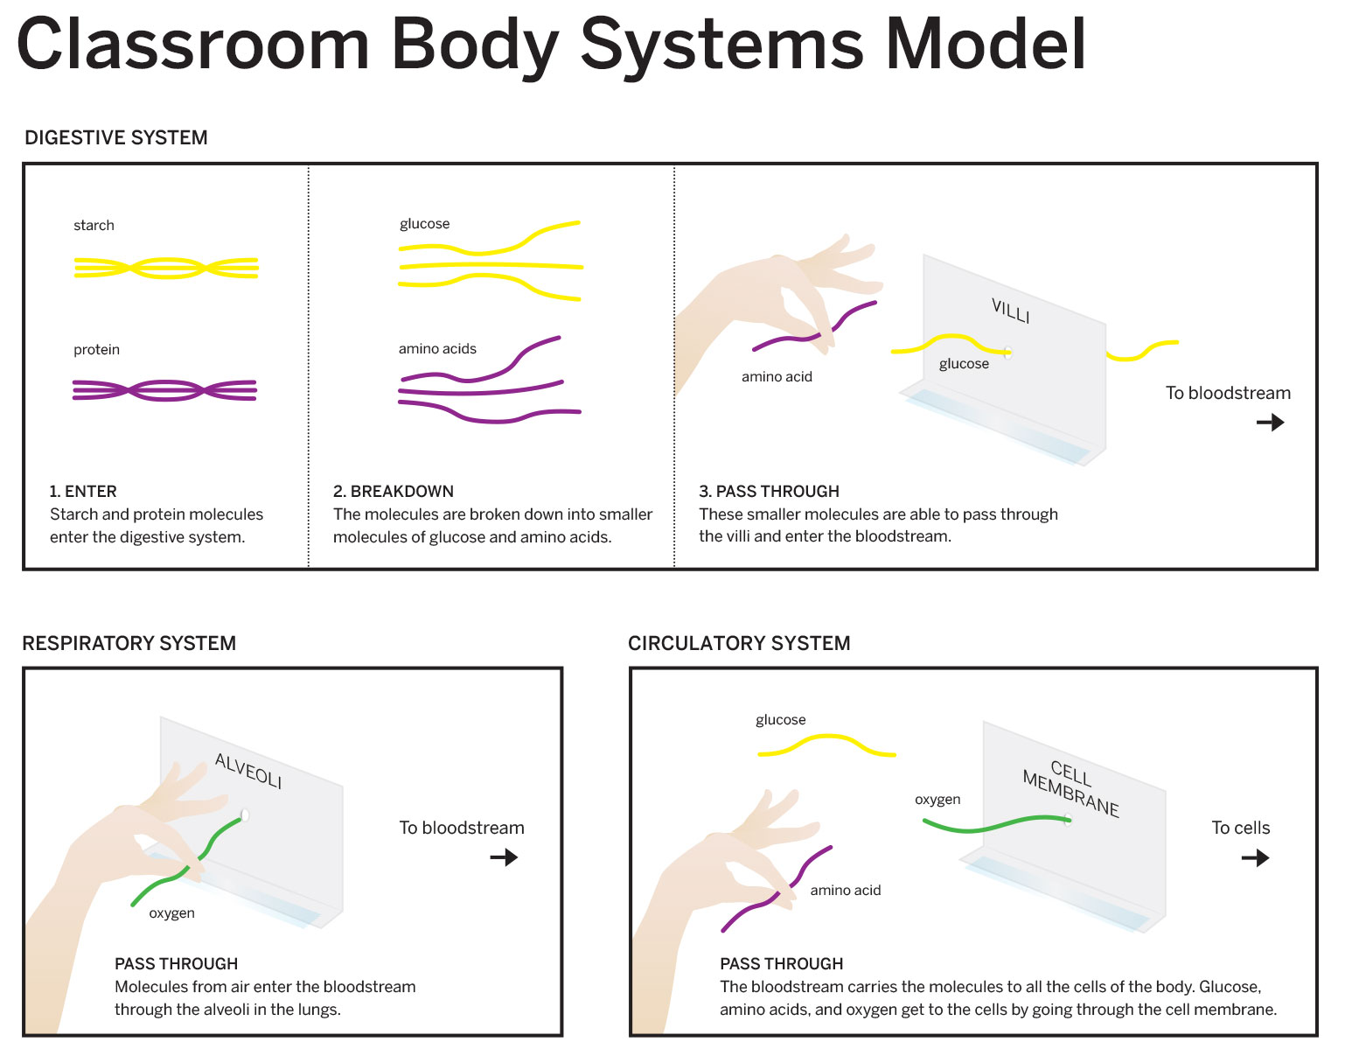

Slide 6
Body Systems Model
In any of the cell roles, you will try to collect the molecules you need by communicating with the circulatory system and requesting specific molecules mentioned on your cell cards.
Let’s watch an animated video that shows you a little bit more about these structures and how they will be represented in the model.
What did you do in your role in the classroom body system model?
WHat did you learn about this body system or the cells in the body from participating in the model?

Slide 7


Slide 8
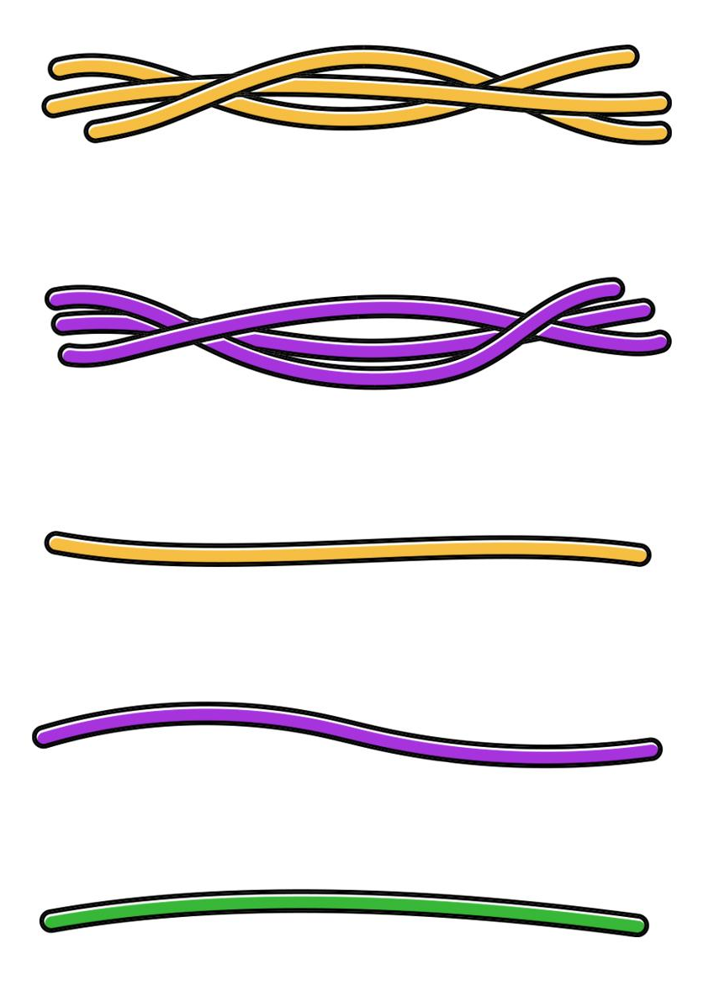
Body Systems Model:
Pipe cleaners represent molecules. The different colors represent different types of molecules.
Large molecules are represented by several pipe cleaners twisted together.
starch
protein
glucose
amino acid
oxygen

Slide 9
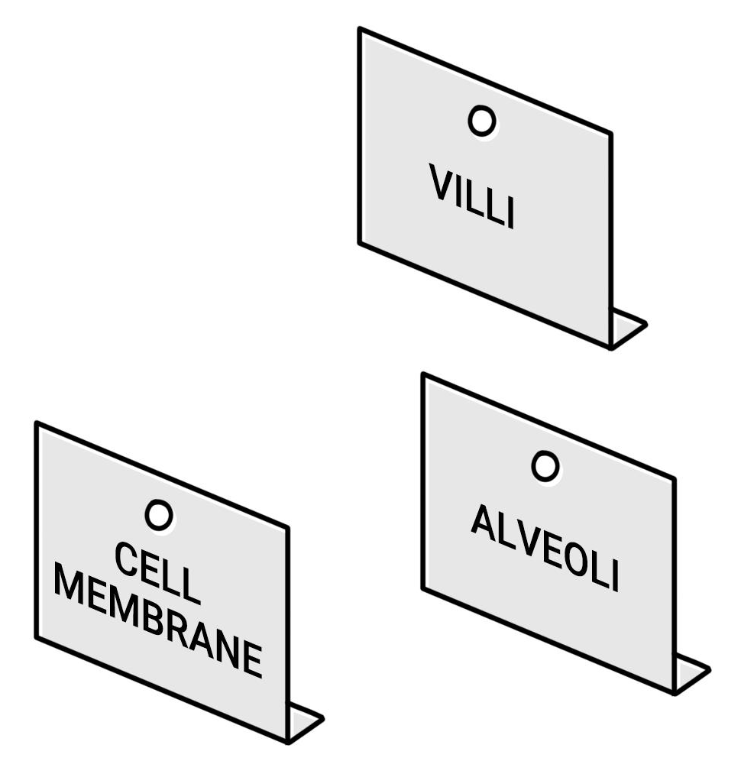
Body Systems Model:
We will use index cards with holes to represent the tiny openings that molecules pass through. There are three types of openings in the model: openings in
  villi,
  alveoli, and the
  cell membrane.
—--------

Slide 10
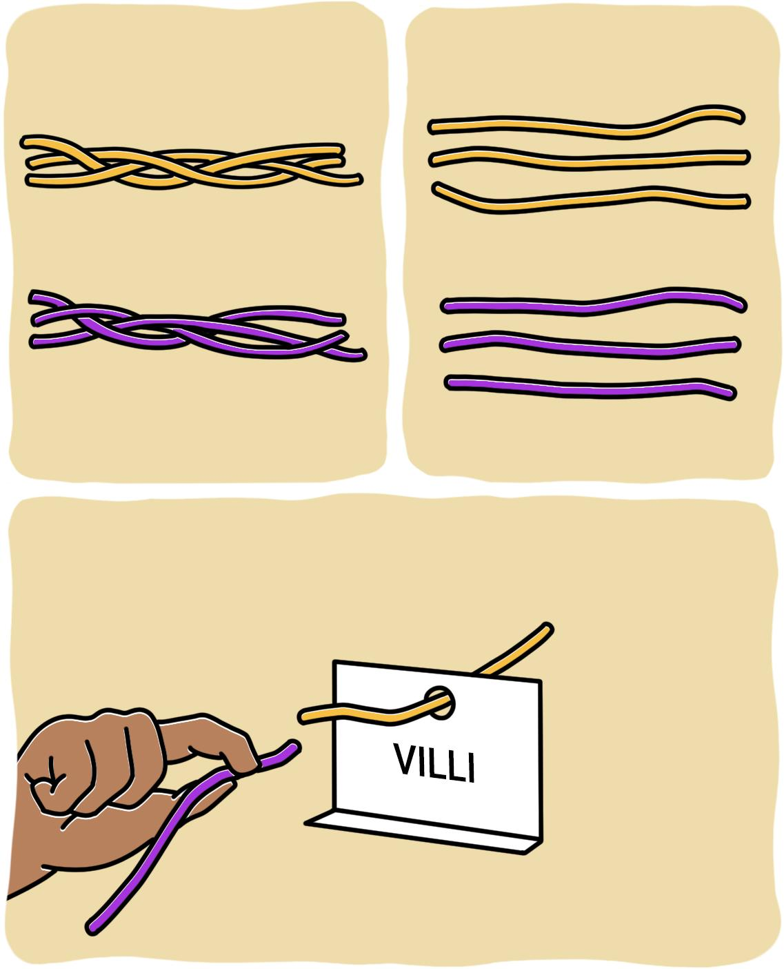
Digestive System
1. Enter
2. Breakdown
In the Digestive System role, you will take one food molecule at a time, break it down into smaller molecules, and then deliver these molecules to the circulatory system.
starch
glucose
protein
amino acids
3. Pass through
to bloodstream
glucose
amino acid

Slide 11
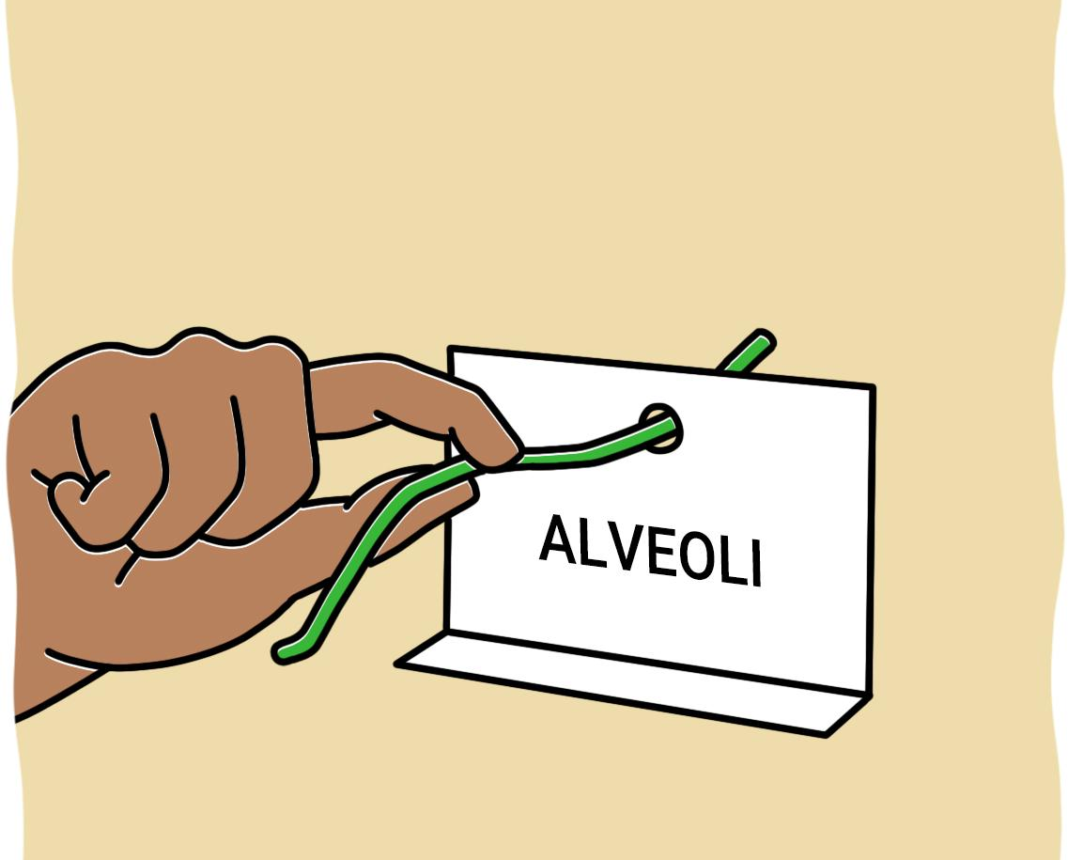
Respiratory System
In the Respiratory System role, you will take one oxygen molecule at a time from the Environment Station and deliver it to the circulatory system.
to bloodstream
oxygen

Slide 12
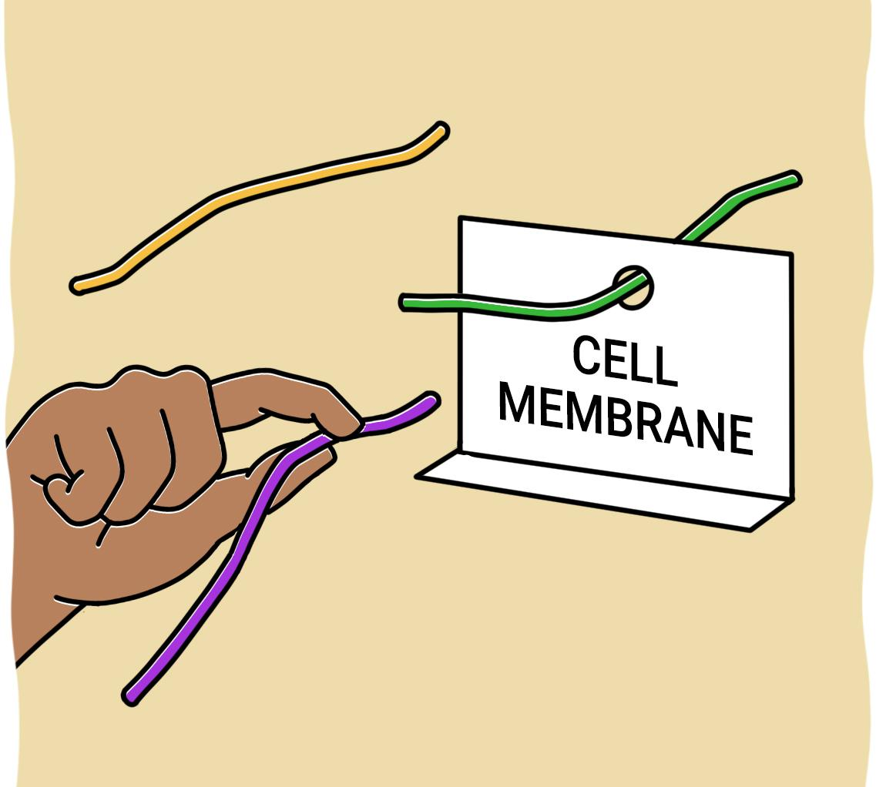
Circulatory System
to cells
In the Circulatory System role, you will pick up molecules at the Lungs Station and Small Intestine Station and carry them to one of the three cell stations.
glucose
oxygen
amino acid

Slide 13
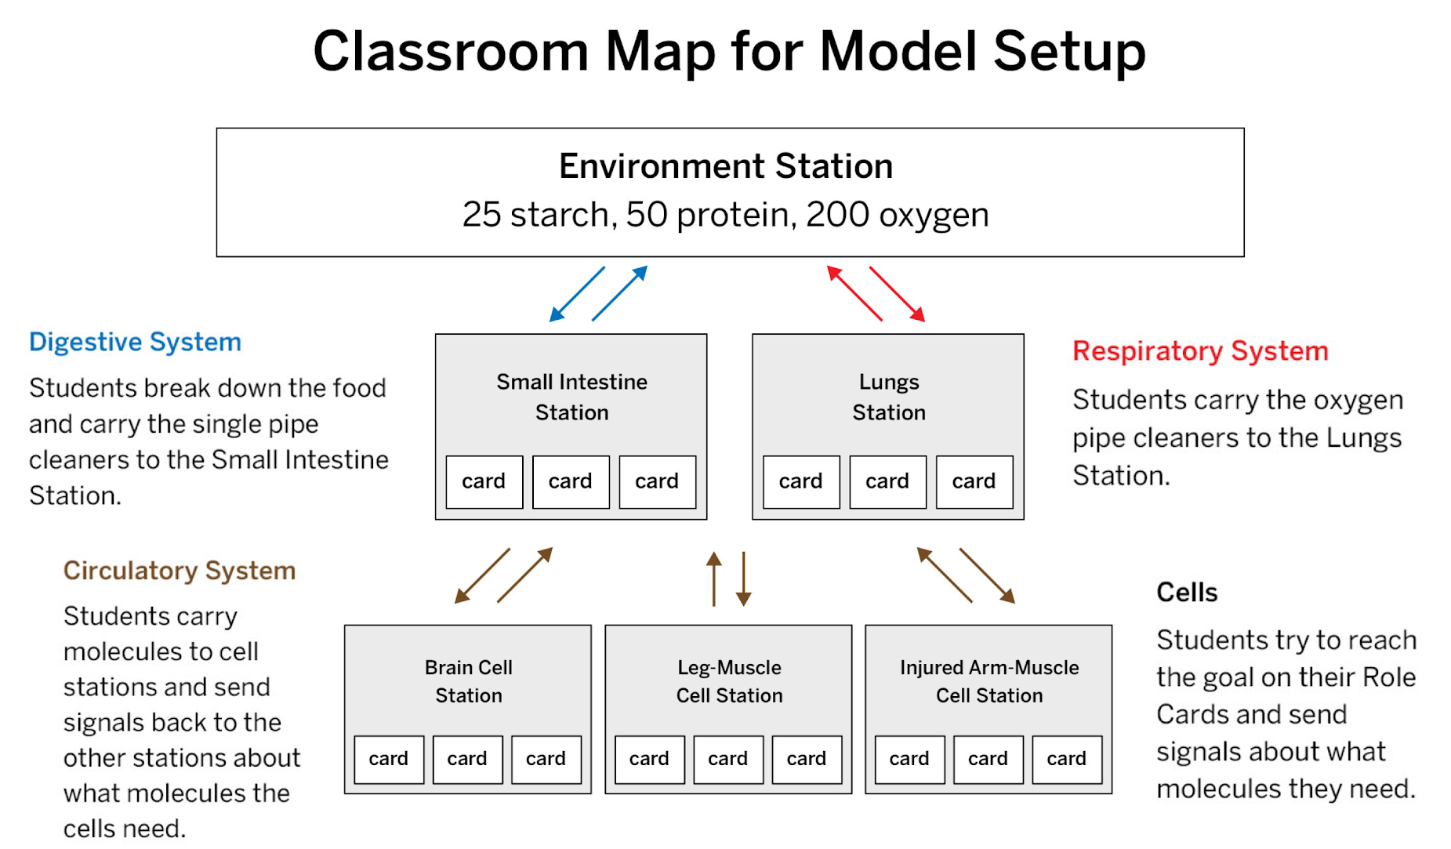

Slide 14
Investigation Question:
How do molecules from food and air get to the cells in the body?

Slide 15
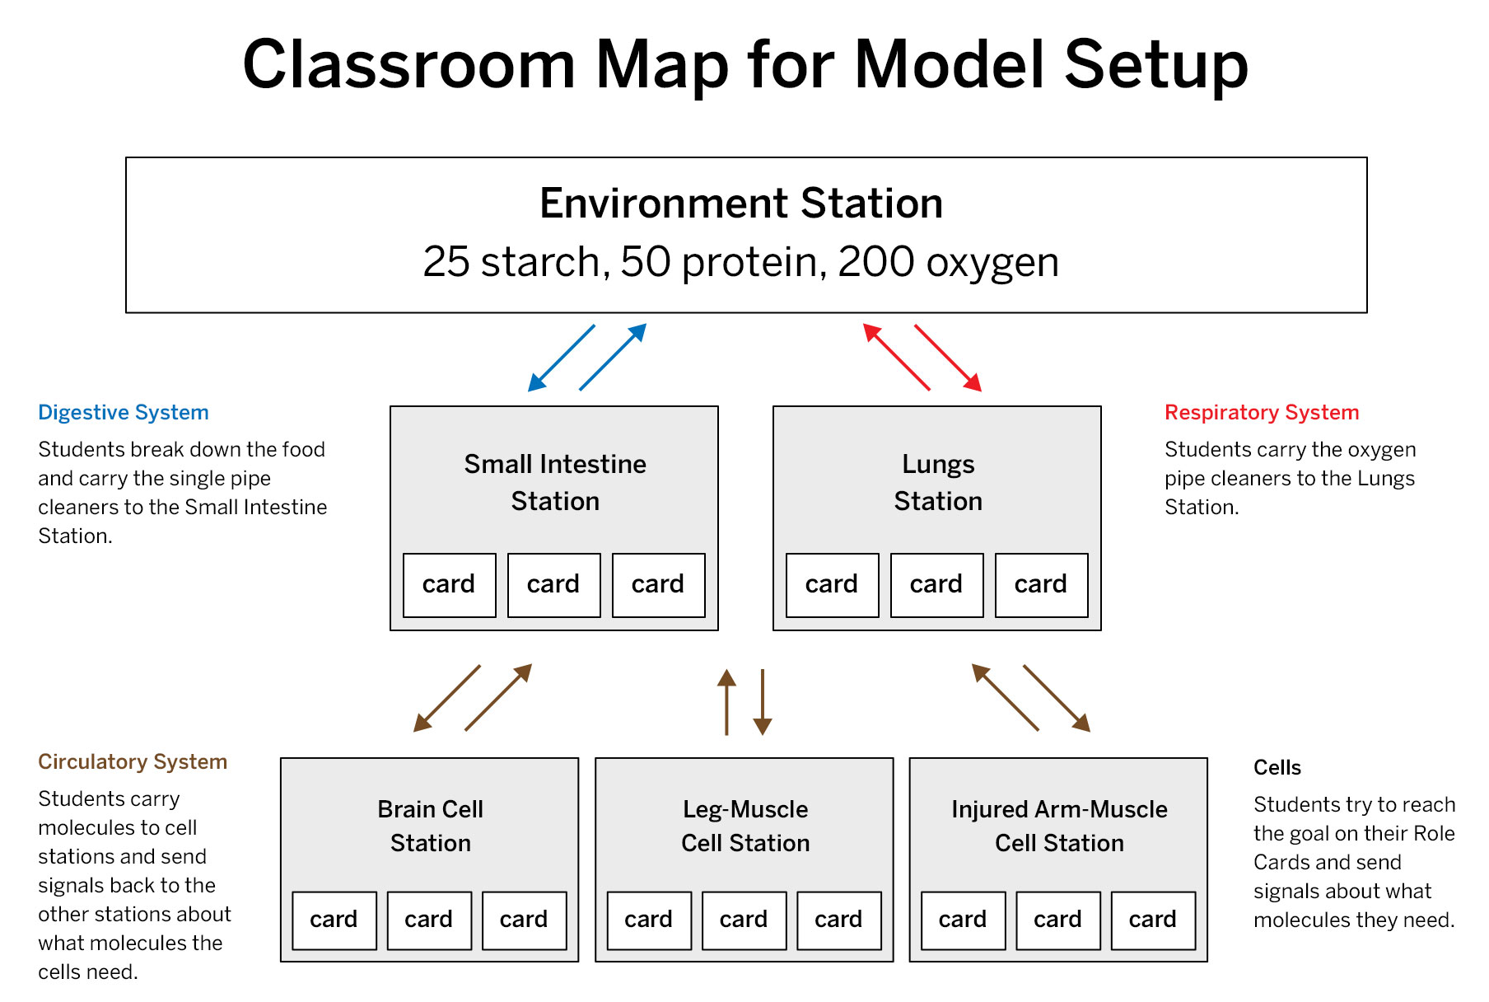
Running the Model

Slide 16
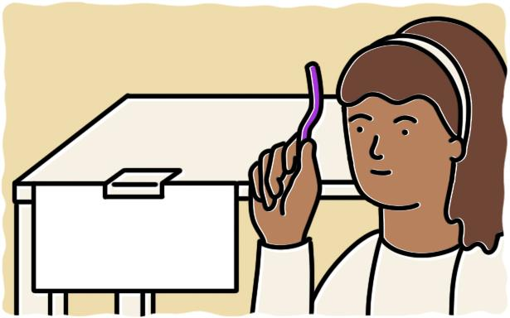
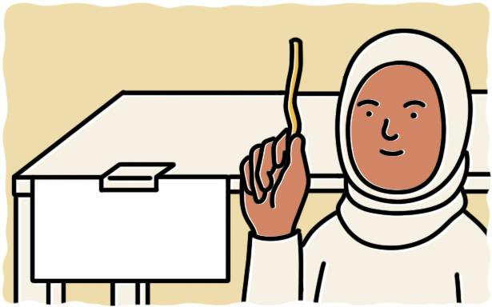
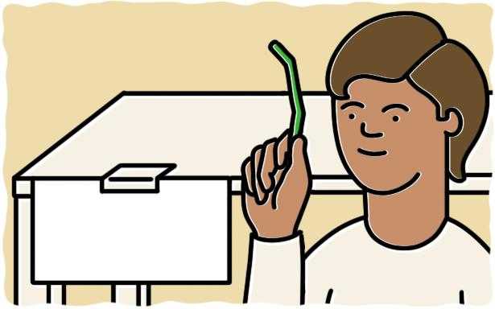
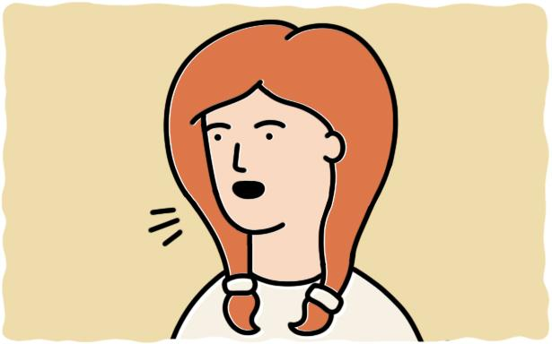
Running the Model
Small Intestine
Station
Lungs
Station
Cell
Station
Digestive System
Respiratory System
Circulatory System
Cell Stations
Start at: Environment Station
Goal: Carry molecules from the Environment Station to the Small Intestine Station.
Start at: Environment Station
Goal: Carry molecules from the Environment Station to the Lungs Station.
Start at: Lungs or Small Intestine Stations
Goal: Carry molecules from the Lungs and Small Intestine to the Cells.
Start at: the station matching your cell
Goal: Collect and send signals about the molecules needed.

Slide 17
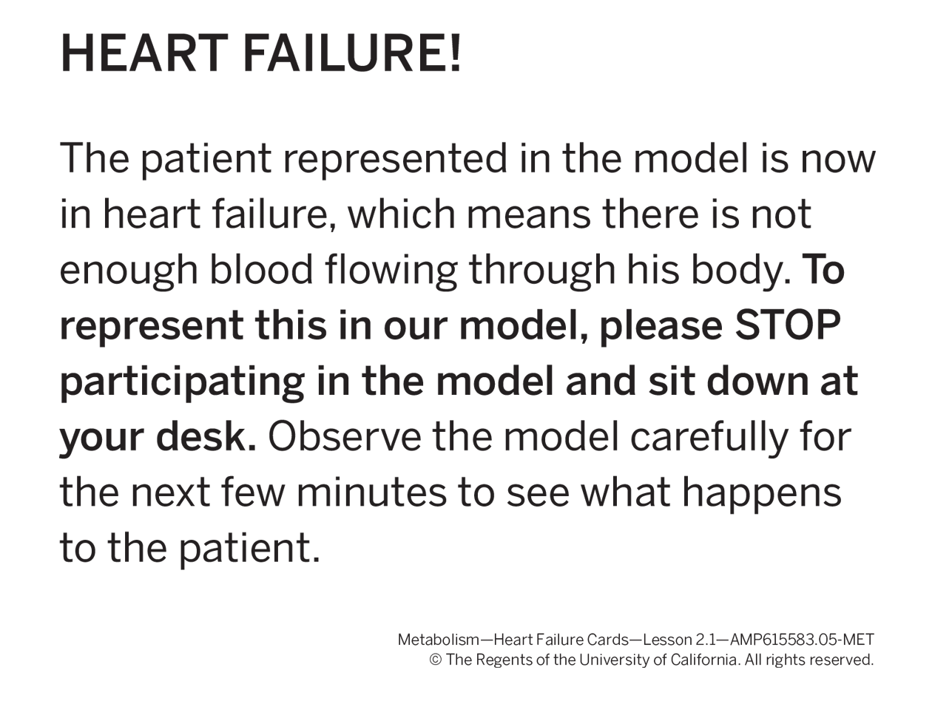
Debriefing the Model
What did you do in your role in the classroom body systems model?
What did you learn about this body system or the cells in the body from participating?
What happened in the last few minutes of the model that changed how the body systems were working?
In real heart failure, the heart cannot pump enough blood to meet the cells’ needs.

Slide 18
Key Concept #1:
What is happening in Elisa’s body that could be preventing molecules from getting to her cells?

Slide 19
Key Concept #2:
Cells can only use molecules that are small enough to enter a cell.

Slide 20
Key Concept #3:
The respiratory system brings in oxygen molecules from the air. These oxygen molecules are already small enough to fit into cells.

Slide 21
Key Concept #4:
The digestive system brings in food and breaks it down into smaller molecules, such as glucose and amino acids, that can fit into cells.

Slide 22
Key Concept #5:
The circulatory system transports glucose, oxygen, and amino acid molecules to every cell in the body.

Slide 23
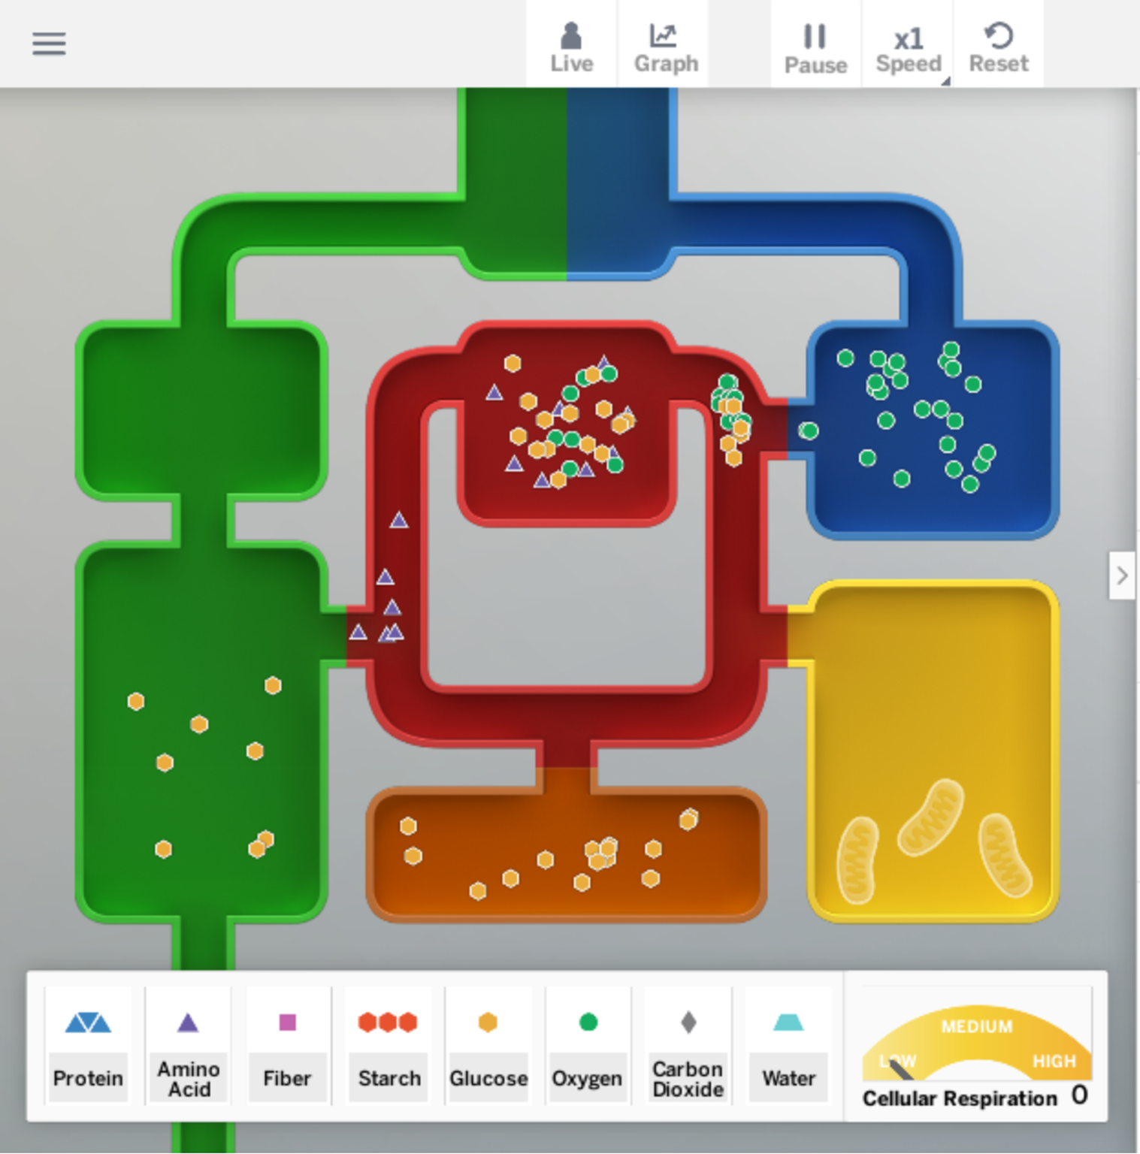
Homework
For this activity, you will observe the different body systems in the Sim and answer questions about what you observe.
Make observations about how the different body systems work in the Metabolism Sim. Record your observations below. Then press NEXT to use what you learned—from your observations and the classroom body systems model—to continue this activity and answer questions about the body.
Launch the Metabolism Simulation, select HEALTHY BODY, and select OBSERVE.
Feed the body sandwiches (which provide a mix of molecule types).
Focus on what happens to starch in the digestive system.
  Turn off all the molecules except for starch and glucose. What do you observe?

